Slide 1
PROJECT 1
Cengiz Imga

Slide 2
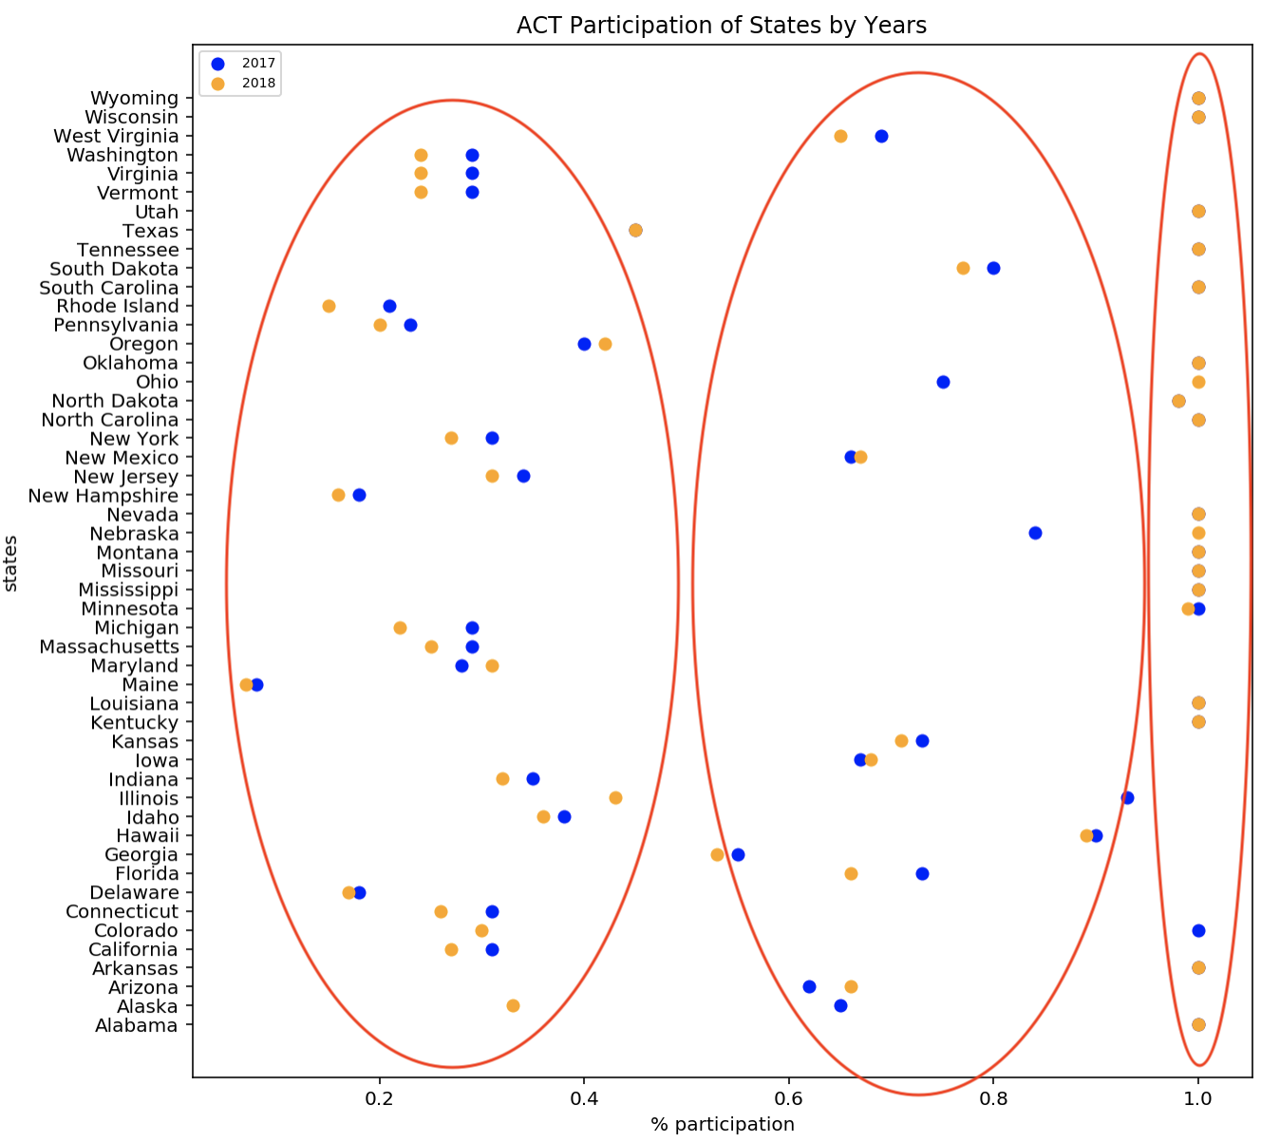

Slide 3
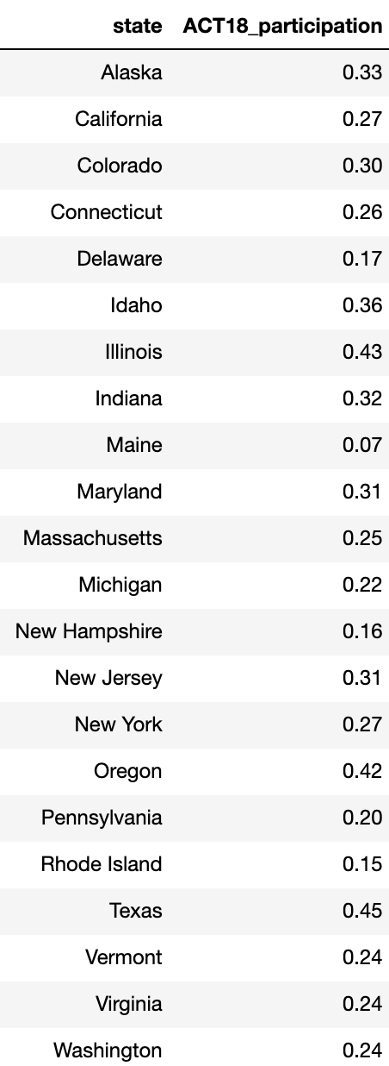
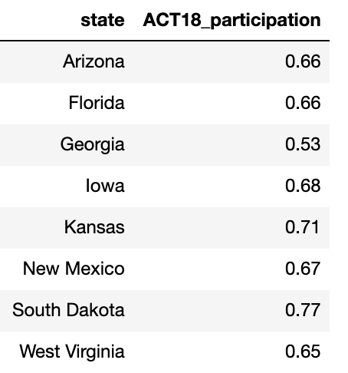
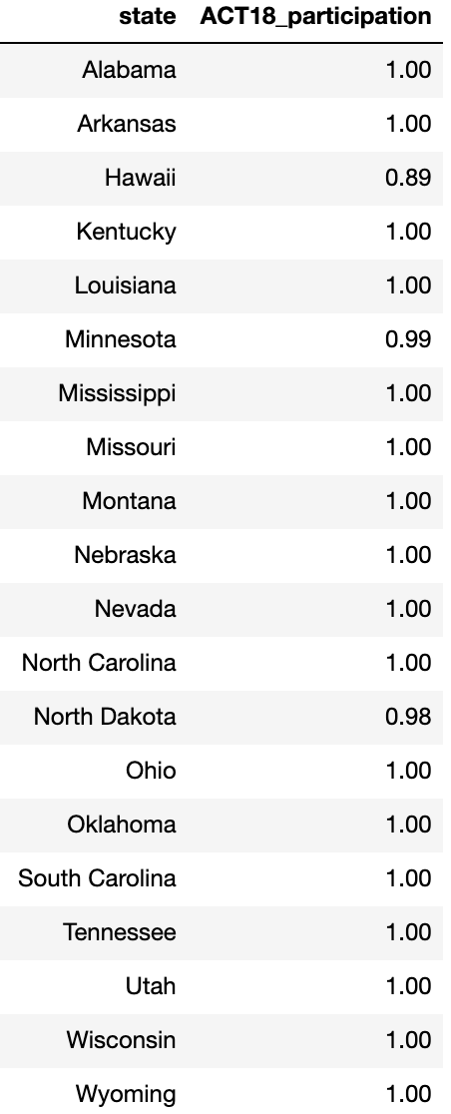
A
B
C
The States in the same group are in the same region?
If yes , so there is a relation btwn region and participation. Then it can be inferred that demography (economy, GDP, culture, education level, encourage education programs like scholarship institutions ) is the main indicator.

Slide 4
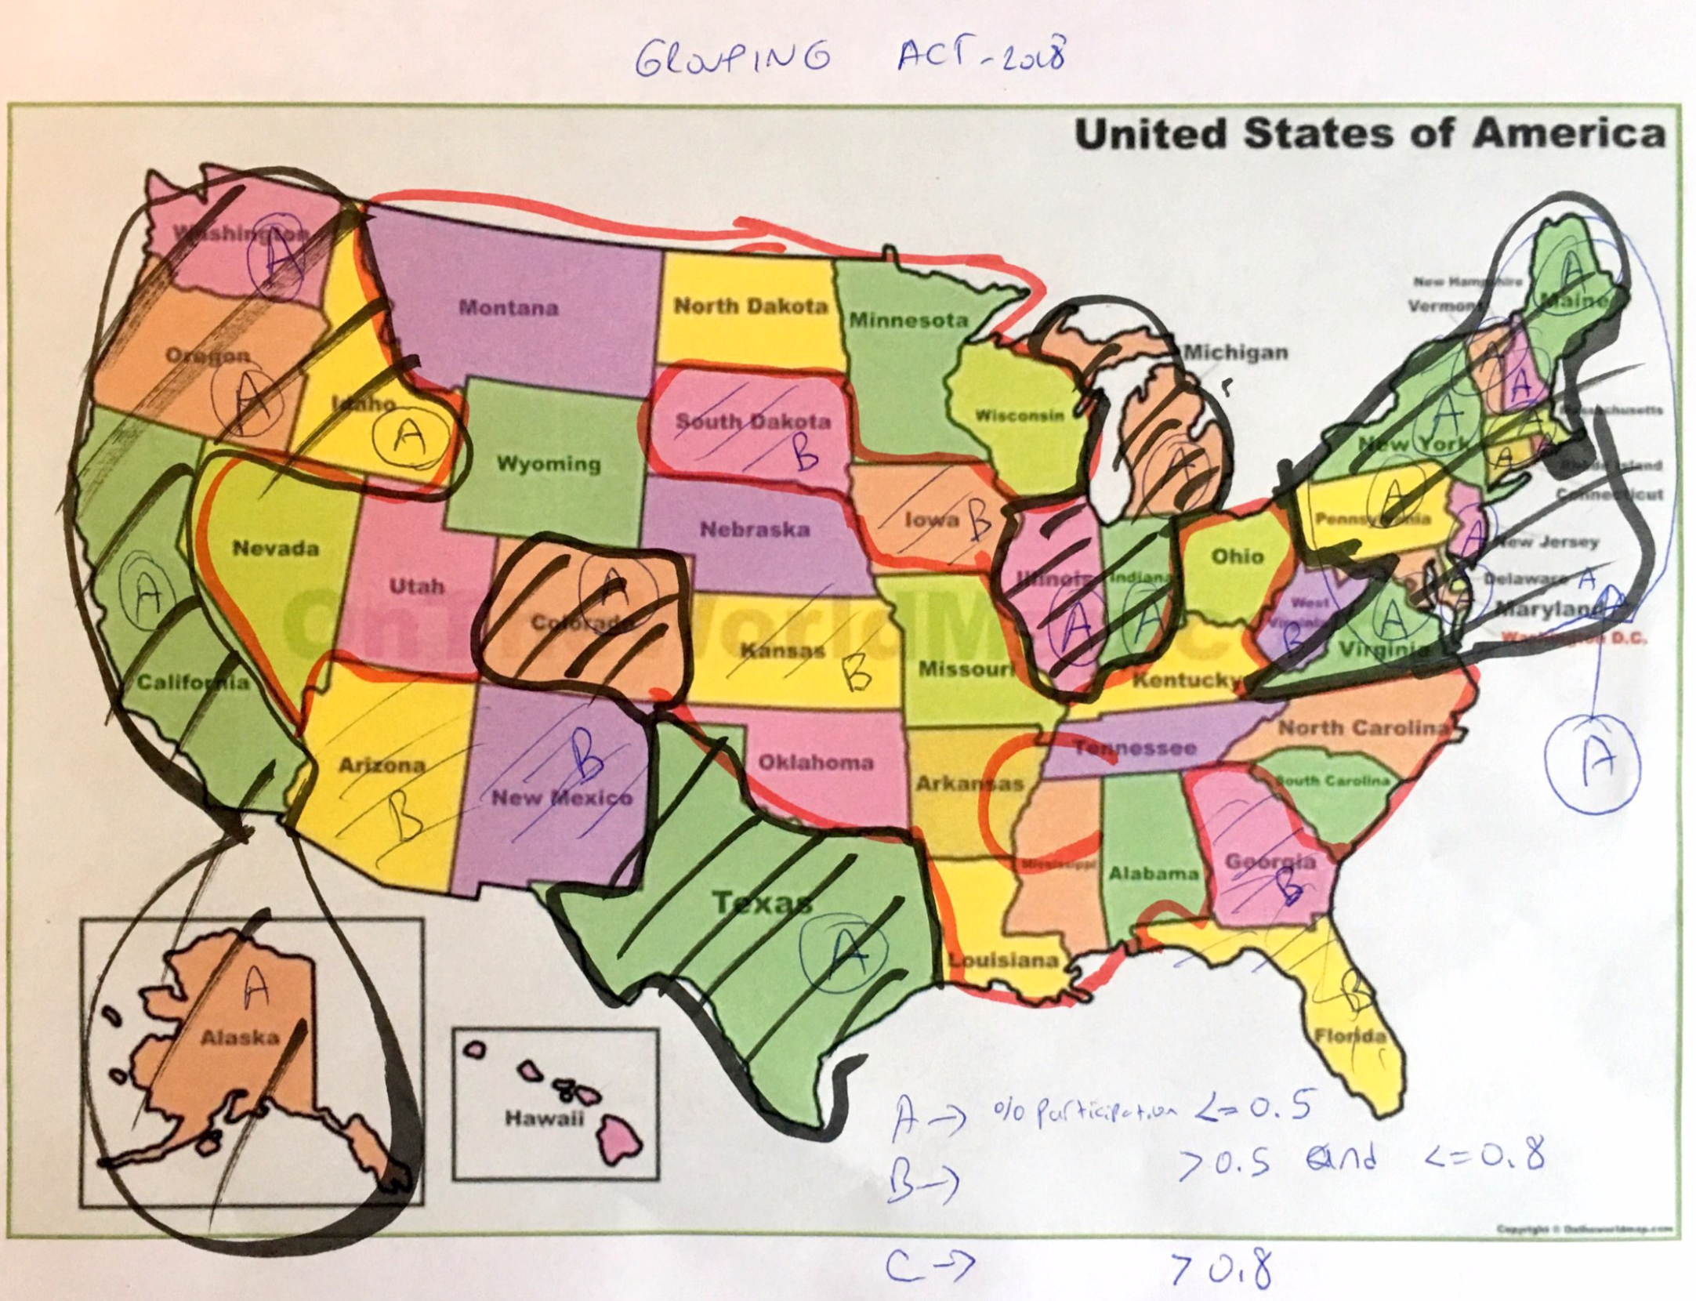

Slide 5
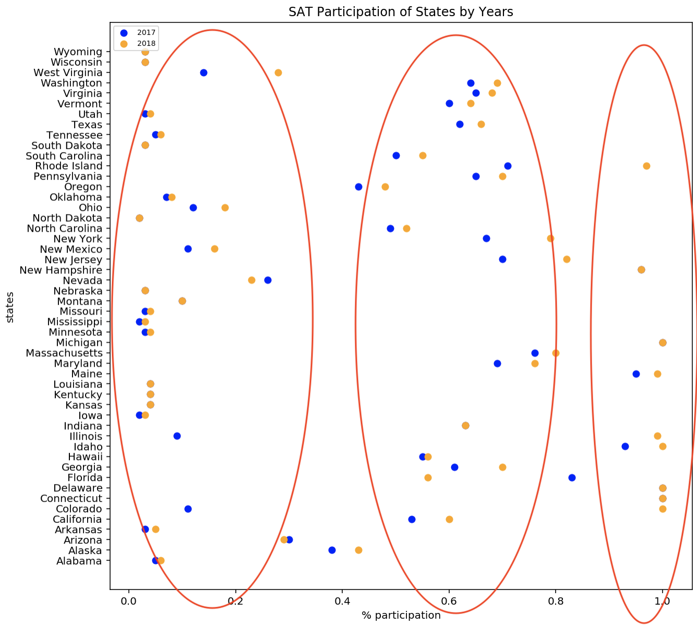
A
C
B

Slide 6
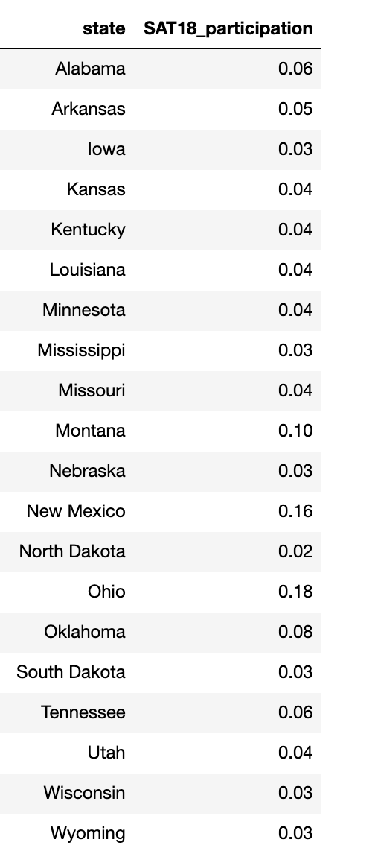
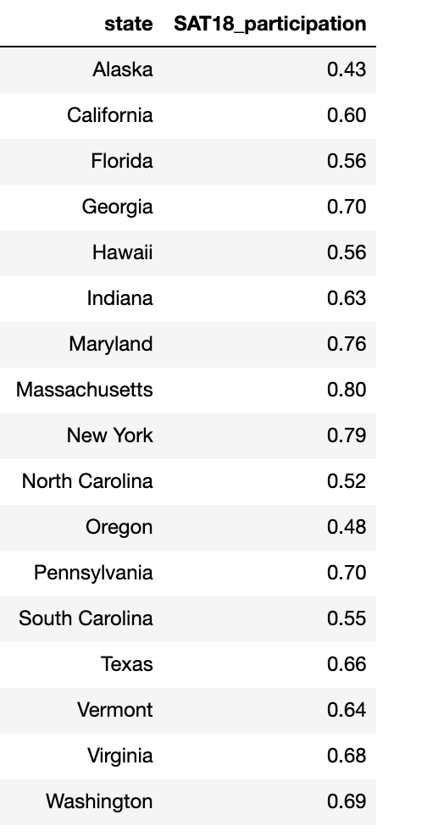
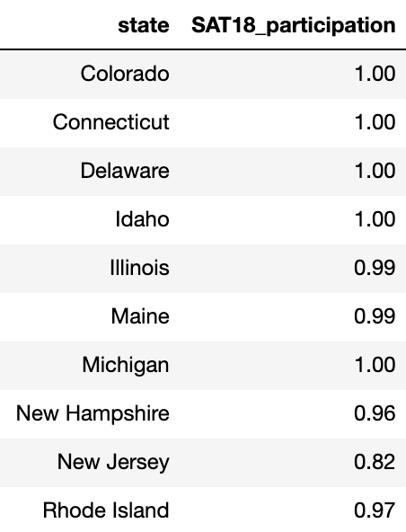
A
B
C

Slide 7
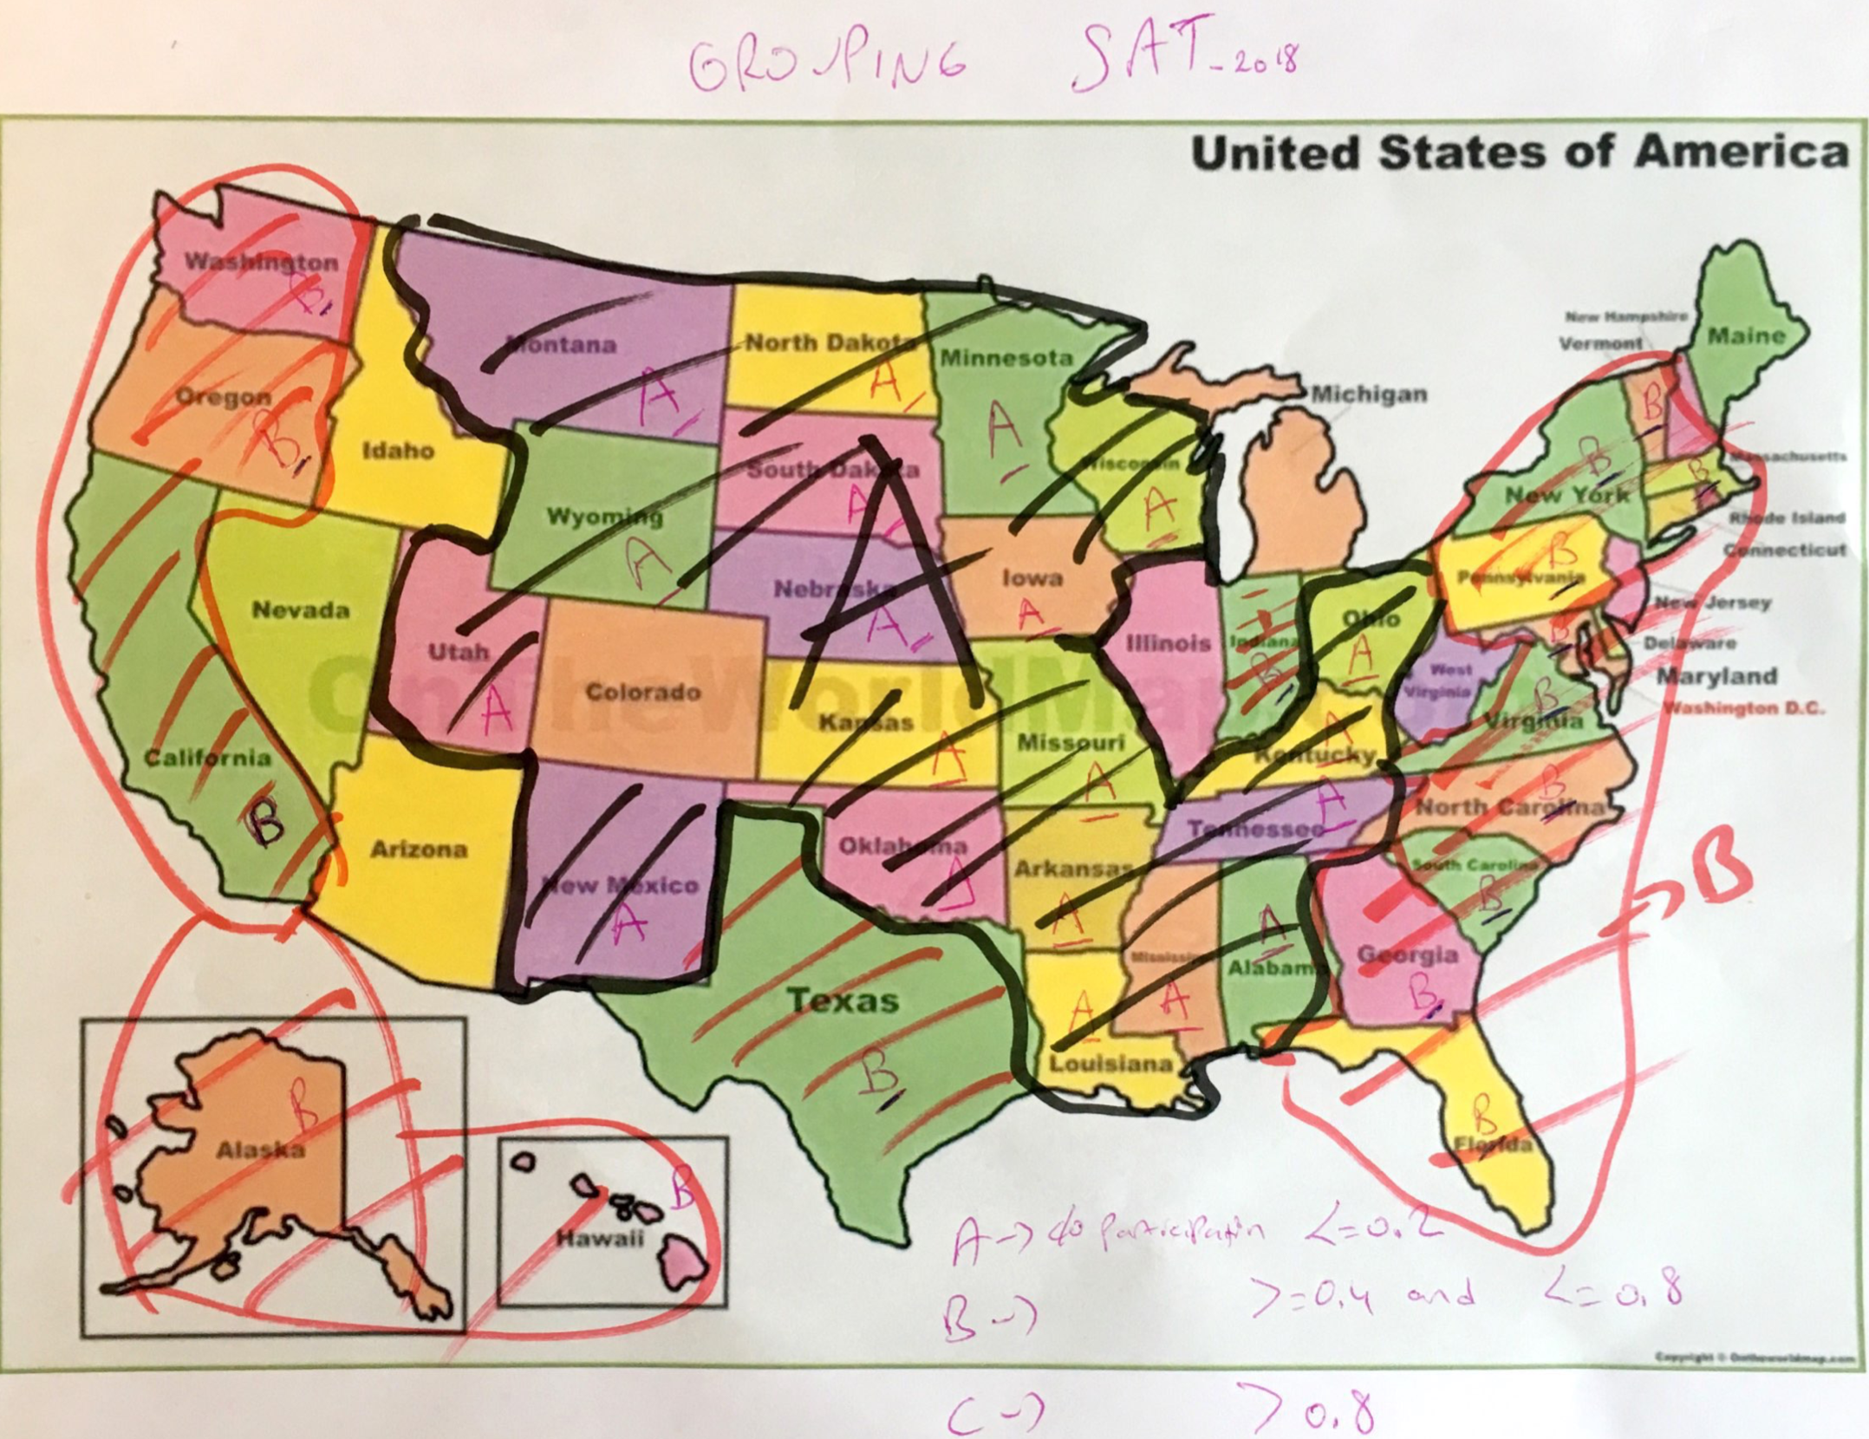

Slide 9
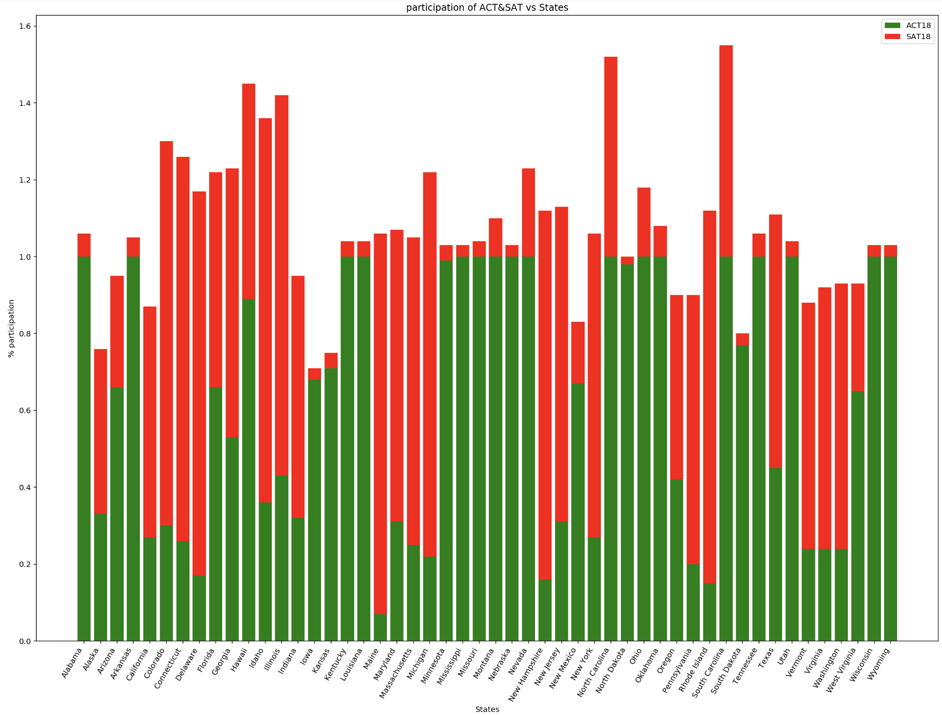
# of the red>green is 21:
most of them is at East Coast region----- ???
# of the green>red is 26:
All of them are spread out to whole country but East Coast.

Slide 10
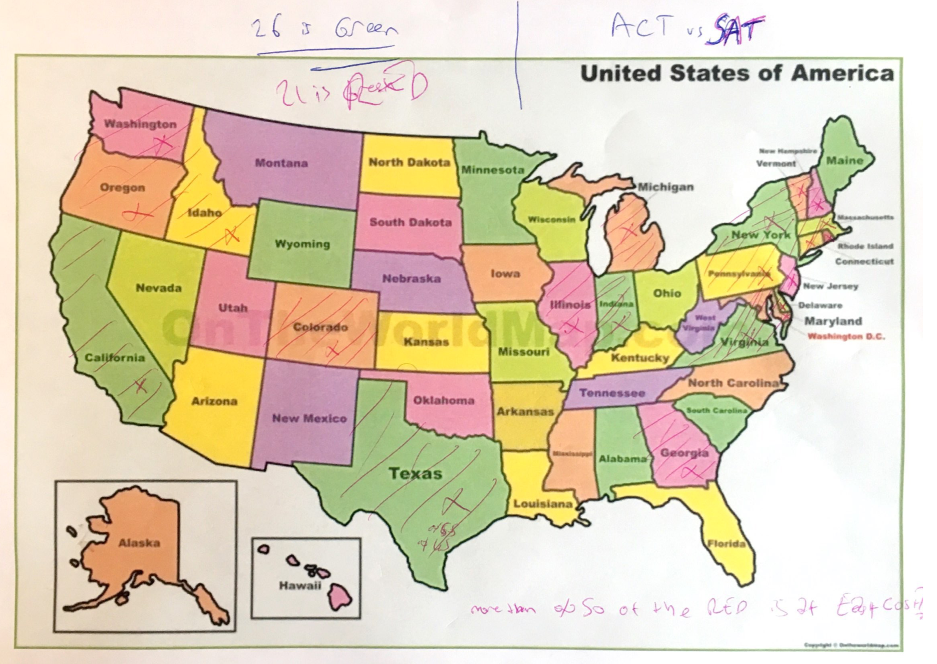

Slide 11
